Slide 1
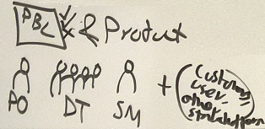
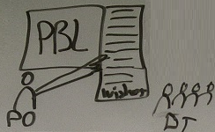

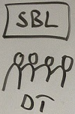
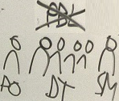
Meeting types in Scrum
SPM1 - refine/update PBL
- prioritize PBL items
- estimate efforts 10-50h
- select PBL items for this Sprint
DSM/DS - What I did since last DSM?
- What I’ll do today(“SBL” tasks)?
- Obstacles/Impediments?
- Sometimes called “standup meeting” because as short as possible. Max 2min / person. Total 5-15mins
Sprint Review PO, DT, SM, (+cust, manag)
- Review the Product (& PBL items.
- PO might accept “Done” PBL items
- Incomplete work back to PBL, sometimes split into done and incomplete
- (Feedback and new direction)
SPM2 - Split (most?some?) selected PBL items into “SBL” tasks
- estimate efforts 2-6h
- prioritize / order (some tasks might have dependencies)
2000-2020 Juhani Välimäki
(Work) - (Workdays e.g. 8h long)
- (Minus lunch => 7.5h, minus coffee breaks =>7h)
- (Minus company trainings, company status meetings, communication, ICT problems, administration => ~6h a day)
- Use 6h in capacity calculations
- PO “reachable" during the day
Sprint Retrospective
- Process(es), people, values, communication, methods, efficiency, learning, tools, templates, …
- Improvements for the process for next Sprint

